Slide 1

Campus Connect: The Community App
Team Code-Astra | CIEL Kingston VibeAIthon 2025
Team Members: HARIGANESH S, SHARAN RAJ H, VIGNESH S, RAJESH I, SHARMILA V

Slide 2
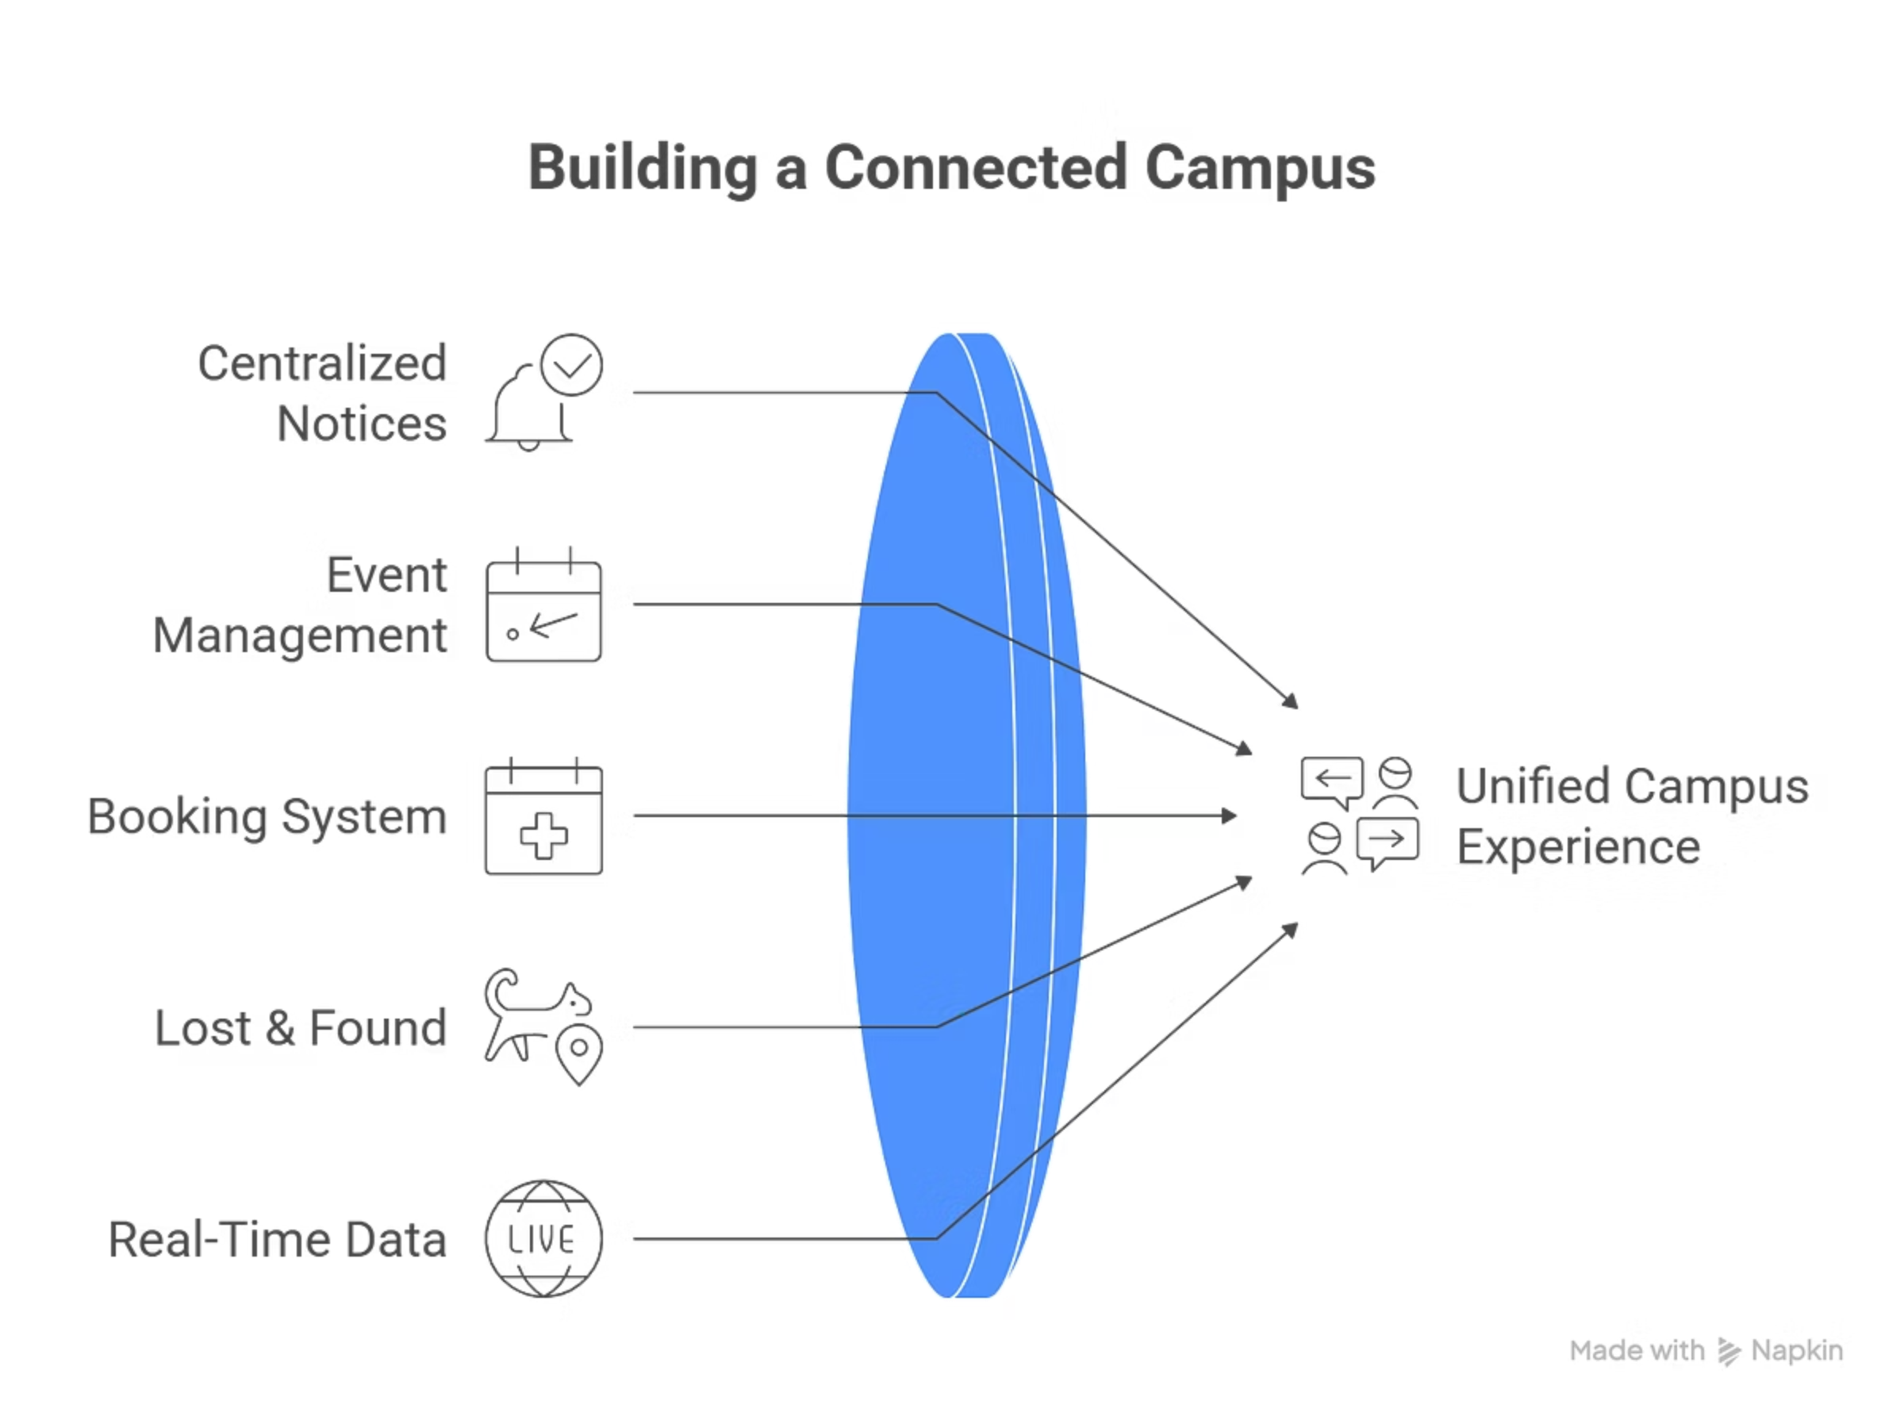
🏫 Campus Connect – Introduction
Campuses often face scattered communication challenges—multiple WhatsApp groups, paper notices, and missed updates create confusion and inefficiency. Campus Connect is a smart digital platform that unifies students, faculty, and administration in one comprehensive system.
Our platform centralizes notices, events, bookings, and lost & found into a single mobile and web application. Built using Node.js, Express, and MongoDB, it ensures real-time data synchronization and smooth performance across all devices.
Campus Connect promotes efficient communication, transparency, and a smarter campus experience for everyone. Reimagine your campus. Redefine your vibe.

Slide 3

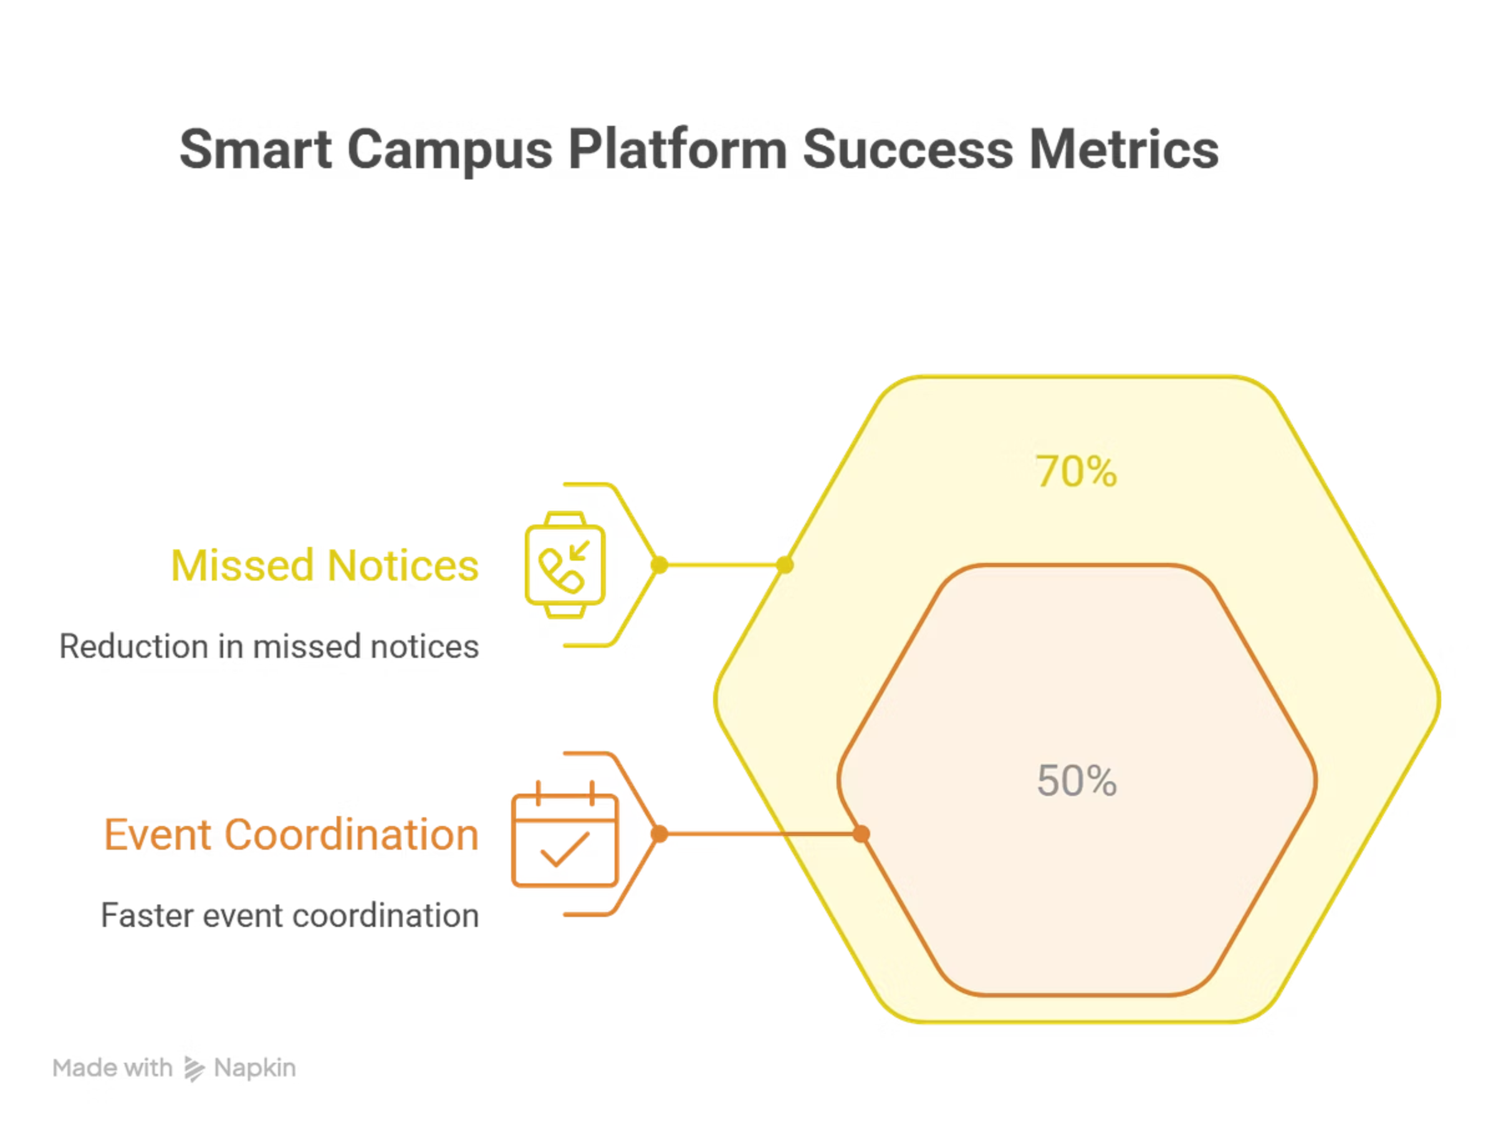

Problem Recap & Objective
The Challenge
Students struggle with scattered communication—missed notices, overlapping events, and manual facility management cause daily frustration and wasted time.
Our Objective
Build a unified smart campus platform connecting students, faculty, and administration in real time for efficient communication and resource management.
Expected Outcomes & Success Metrics
70%
50%
100%
Reduction
Faster
Paperless
in missed notices across campus
event coordination time
communication & booking system

Slide 4
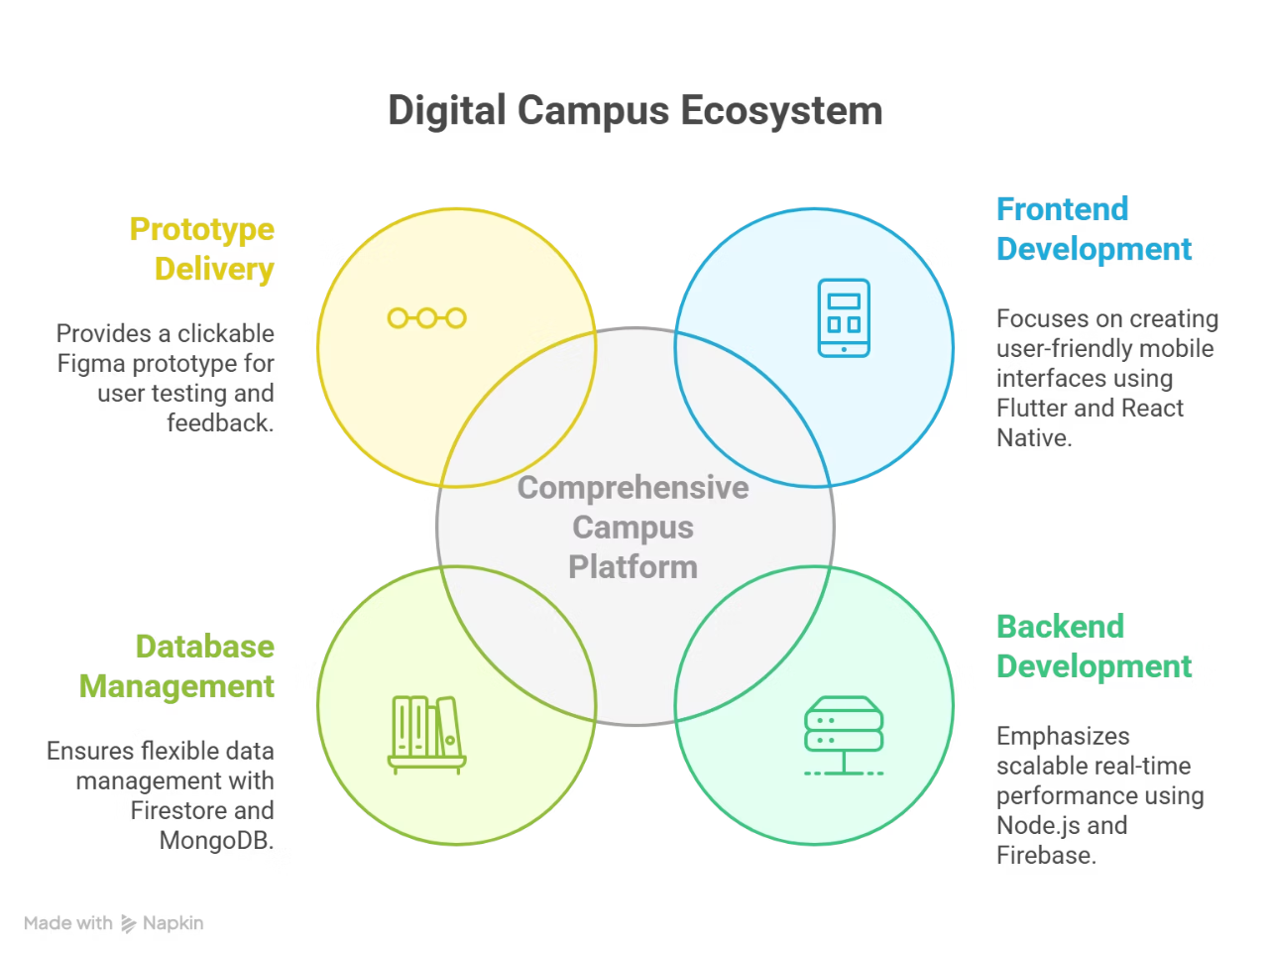
Prototype Overview
All-in-One Campus Solution
Our comprehensive platform brings together notices, events, facility bookings, and lost & found in a seamless digital experience accessible from any device.
Technology Stack
Frontend: Flutter / React Native for cross-platform mobile excellence
Backend: Node.js / Firebase for scalable real-time performance
Database: Firestore / MongoDB for flexible data management
Delivered as a clickable Figma prototype showcasing both mobile and web experiences, ready for immediate user testing and feedback.

Slide 5
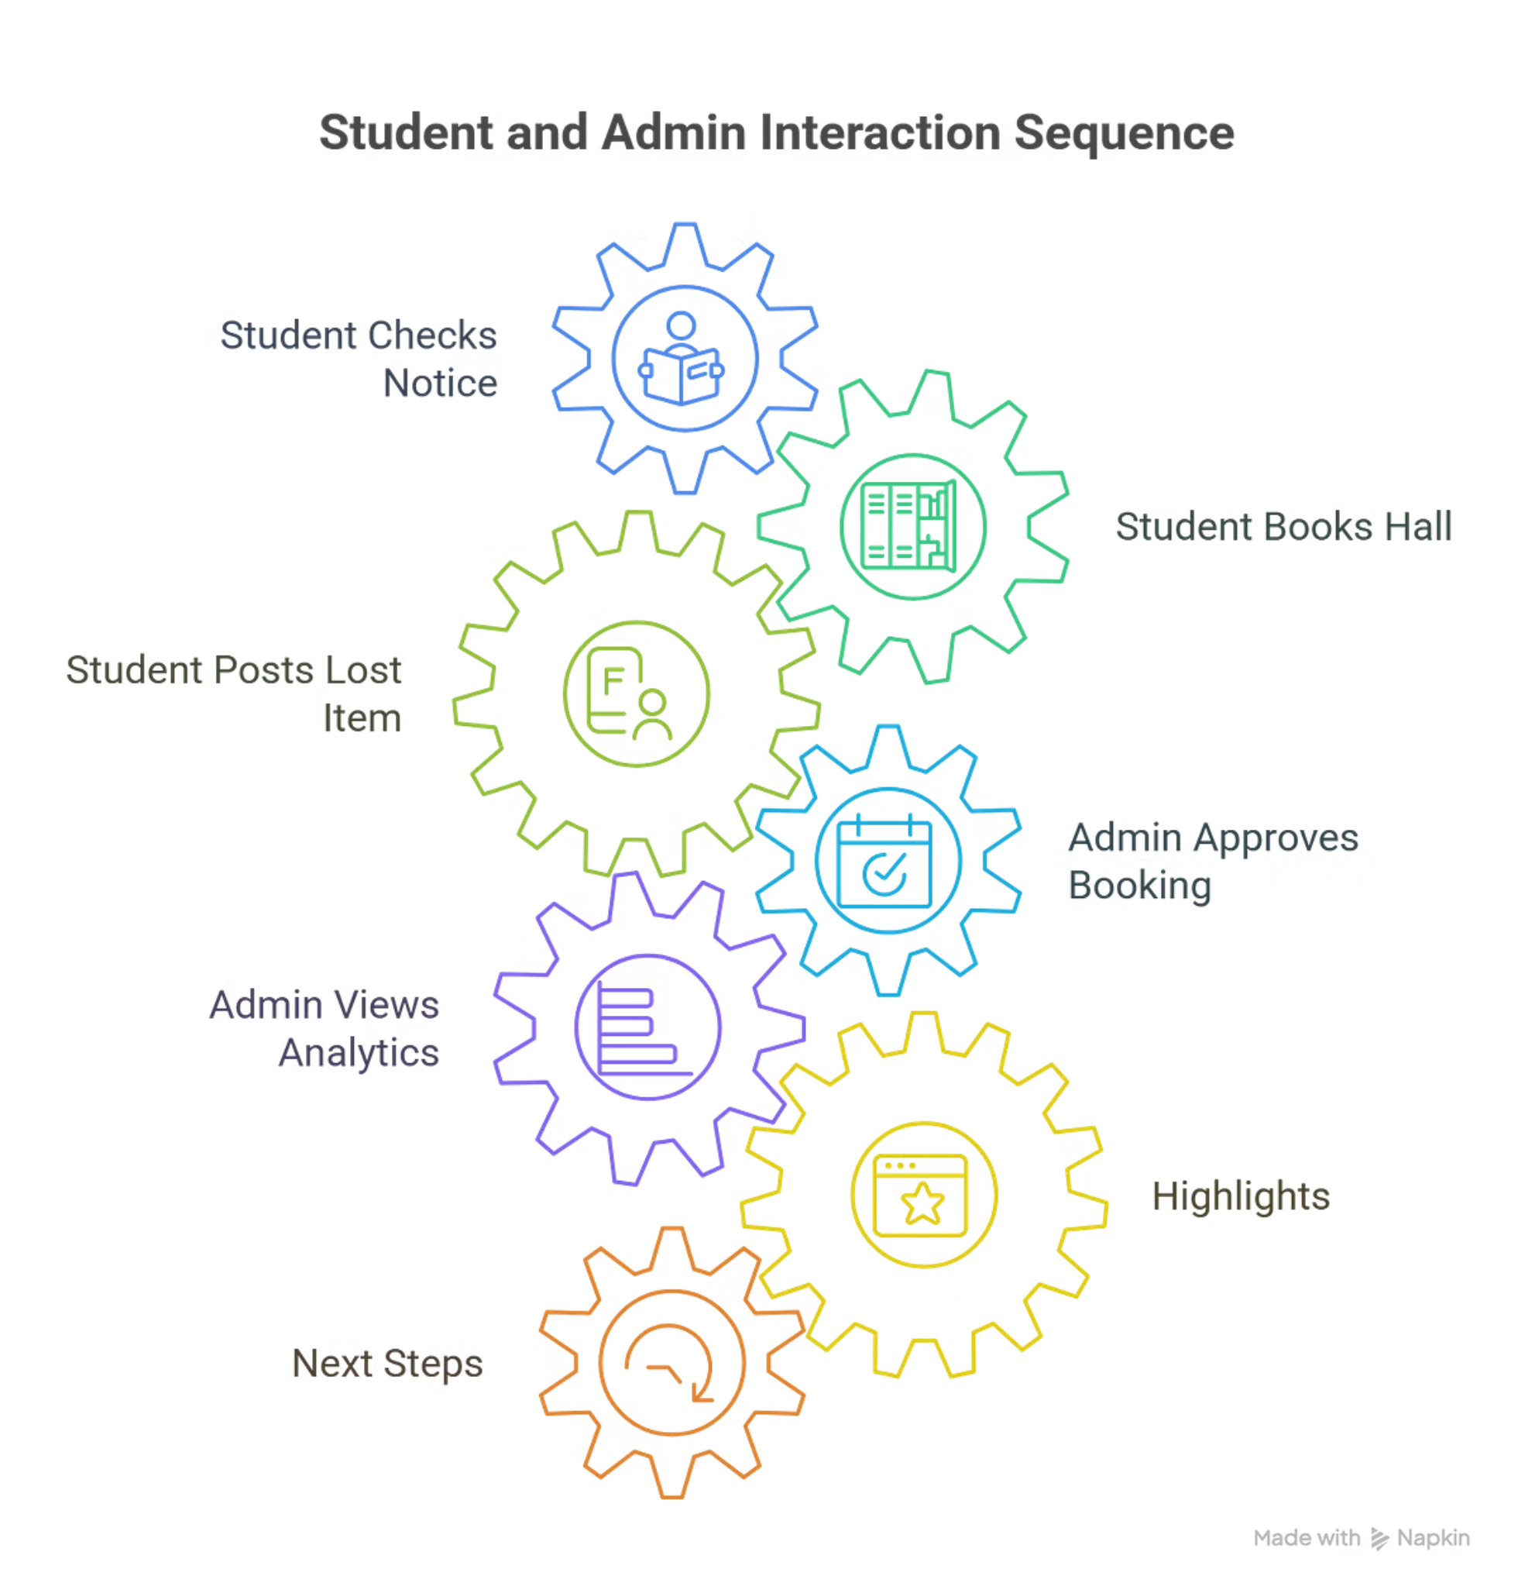


User Experience & Impact
Student Journey
Checks daily notices → Books study hall → Posts lost item → Receives instant updates
Admin Control
Approves booking requests → Views usage analytics → Manages campus resources efficiently
Platform Highlights
📋 Unified Notice Board
🎯 Smart Booking System
Single source of truth for all campus communications
Automated scheduling prevents conflicts and saves time
🔮 IoT Integration
Future-ready with smart building connections
Coming Next: AI-powered chatbot assistance and AR navigation for seamless campus wayfinding.

Slide 6
Key Features of Campus Connect
📢 Notices & Announcements
🎉 Campus Events
Stay updated with all academic and administrative information in one centralized location. Receive real-time alerts for class schedules, exam updates, circulars, and emergency notifications—ensuring no important news is ever missed.
Discover and participate in all college activities effortlessly. A dynamic event calendar showcases upcoming fests, workshops, club meetings, and guest lectures with built-in RSVP options and smart reminders.
🏫 Facility Bookings
🔎 Lost & Found
Simplify the process of reserving campus spaces and resources. Students and staff can book classrooms, labs, auditoriums, or sports facilities through an integrated scheduling system, reducing conflicts and eliminating manual coordination.
A dedicated space to help students report or recover lost belongings. Users can upload item details and images, view reports from others, and connect directly for retrieval—promoting a helpful and trustworthy campus culture.

Slide 7

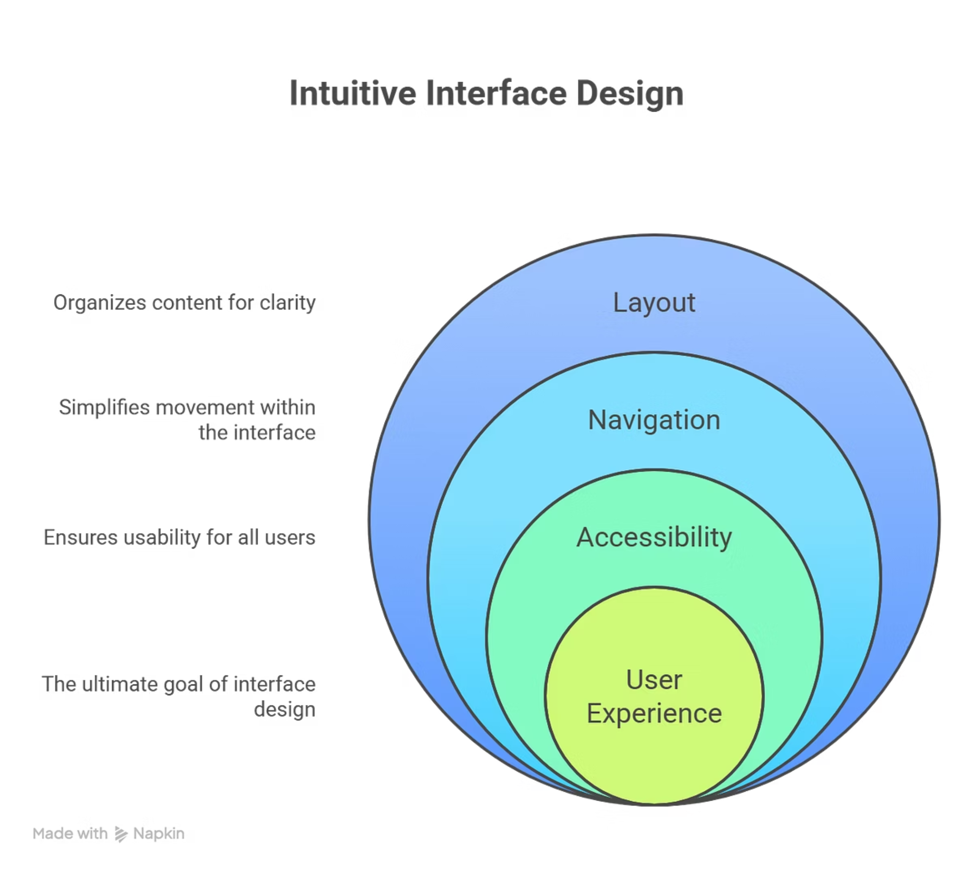
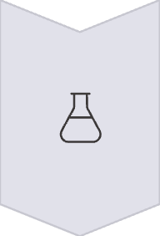
Screenshots & Wireframes
Our intuitive interface design prioritizes user experience with clean layouts, easy navigation, and accessibility features that work seamlessly across mobile and desktop platforms.
Intuitive Interface
Clean, uncluttered layouts with logical information hierarchy ensure users find what they need effortlessly, minimizing cognitive load.
Seamless Adaptability
Fully responsive design for mobile and desktop, integrating accessibility features like high contrast modes and keyboard navigation for all users.
Design Principles & Tools
Wireframe & Prototyping
Visual Design Language
Utilizing industry-standard tools (Figma, Sketch) for detailed wireframes and high-fidelity prototypes, focusing on user flows and interaction design.
Consistent brand identity, typography, and color palettes applied across all screens to create a cohesive, professional, and visually appealing aesthetic.
User-Centered Iteration
An agile design process incorporating usability testing and user feedback to continuously refine and improve the interface based on real-world interactions.

Slide 8
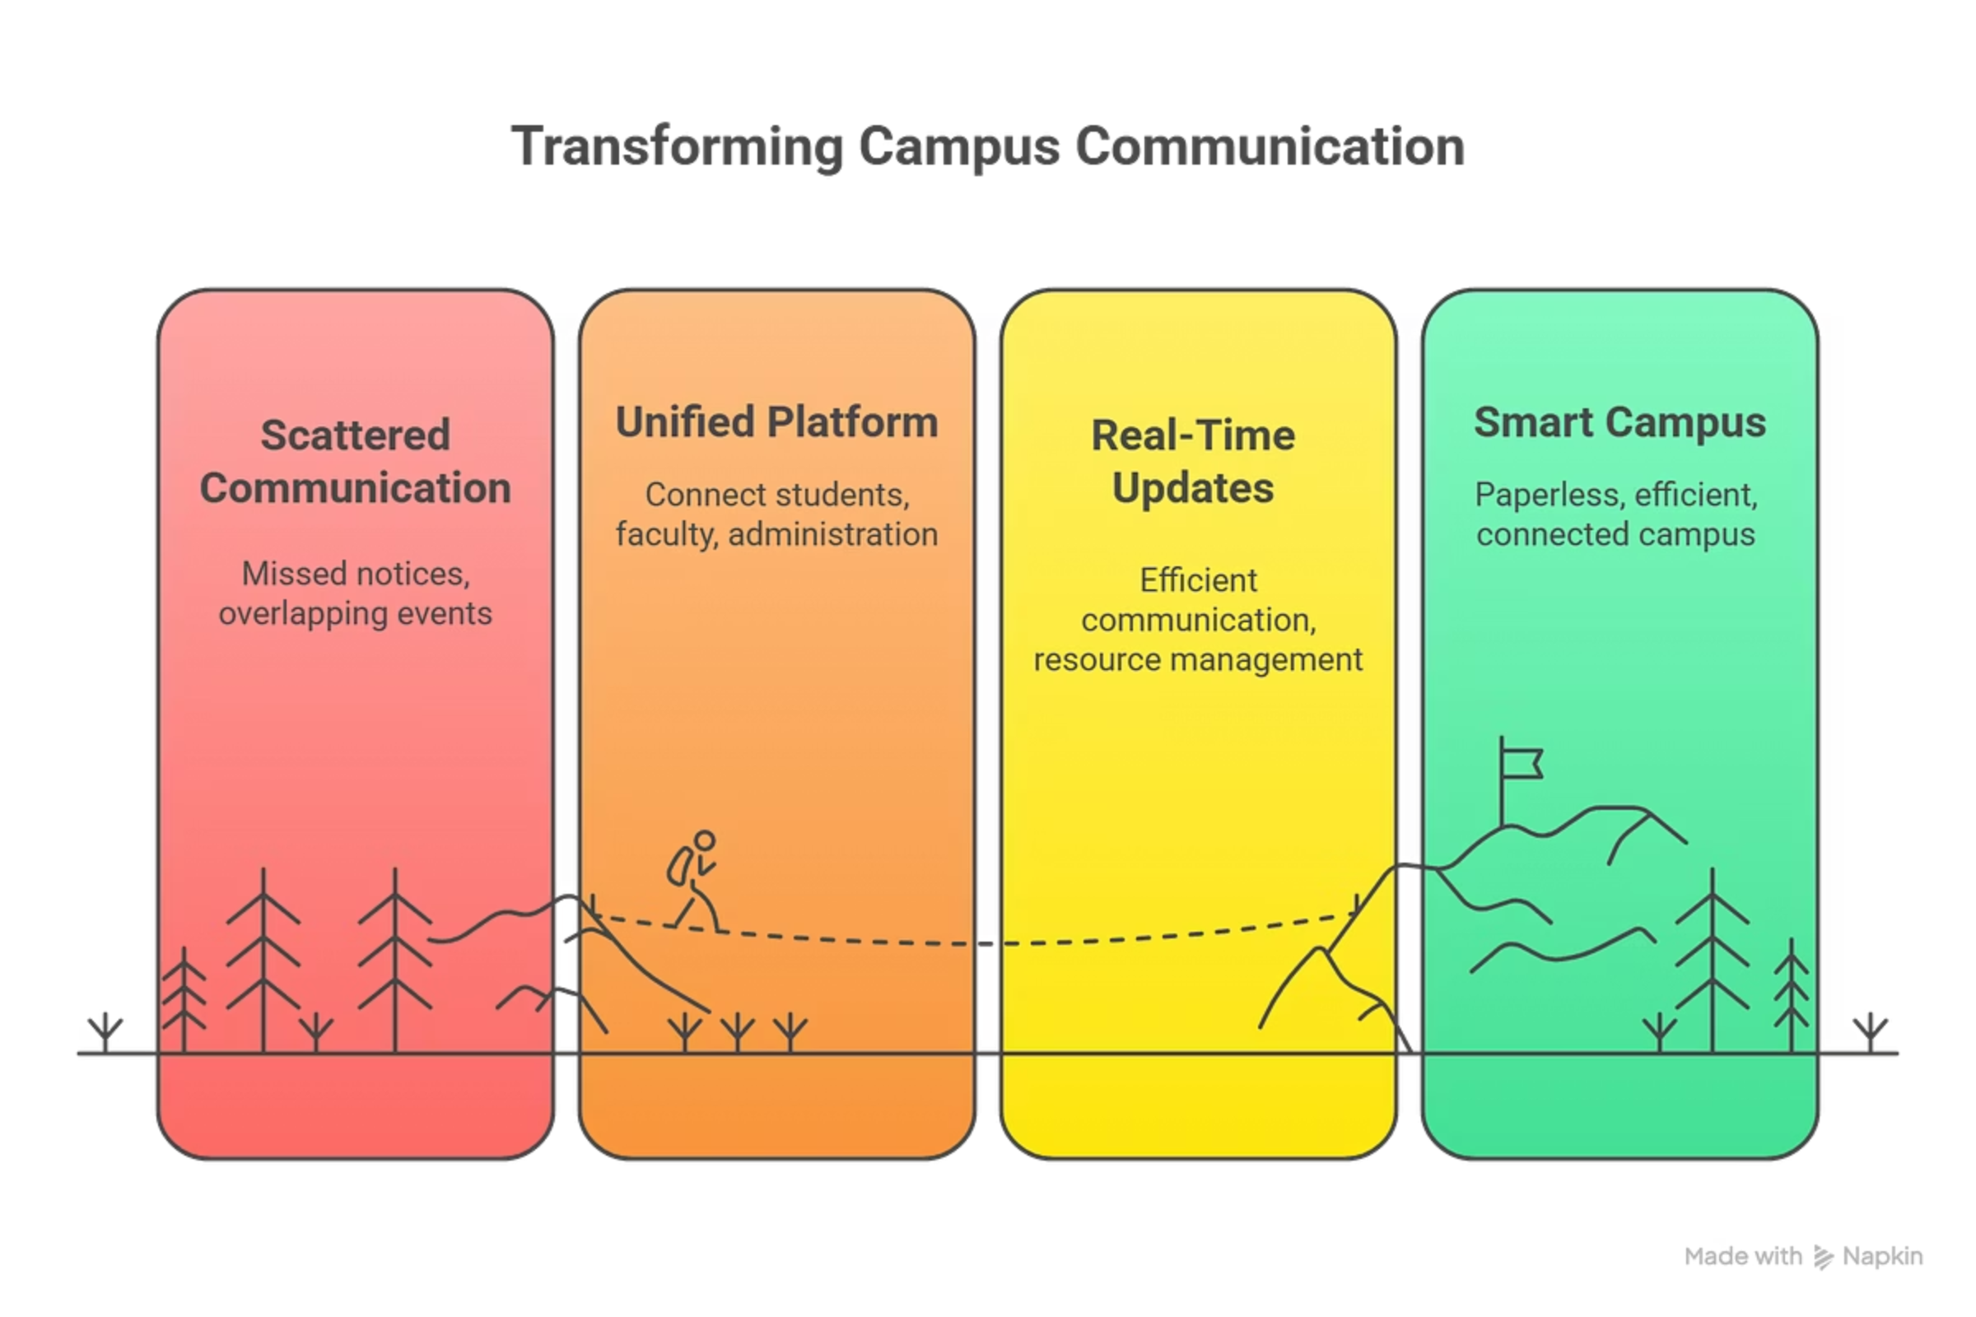
🌐 Transforming Campus Communication
1
📄 Scattered Communication
Missed notices, overlapping events, and disconnected updates create confusion and inefficiency across campus, leading to frustration and wasted resources.
2
🔗 Unified Platform
Brings together students, faculty, and administration in a single digital ecosystem for seamless interaction, collaboration, and information sharing.
3
⚡ Real-Time Updates
Ensures instant communication and better resource management, reducing delays and miscommunication while improving overall campus coordination.
4
🧭 Smart Campus
Promotes a paperless, efficient, and connected campus environment, paving the way for a modern and sustainable academic future.

Slide 9

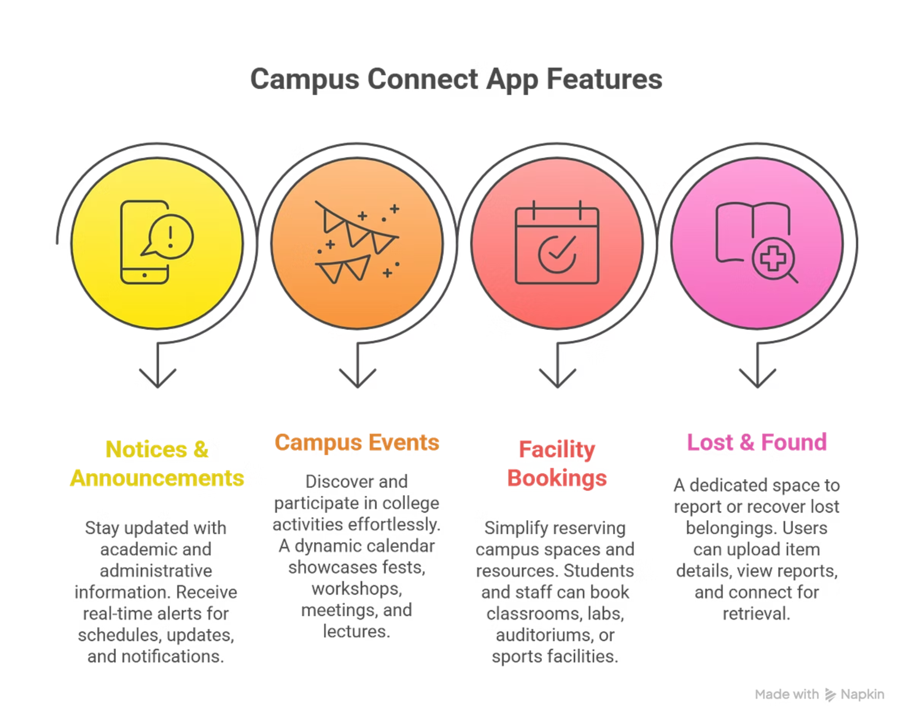


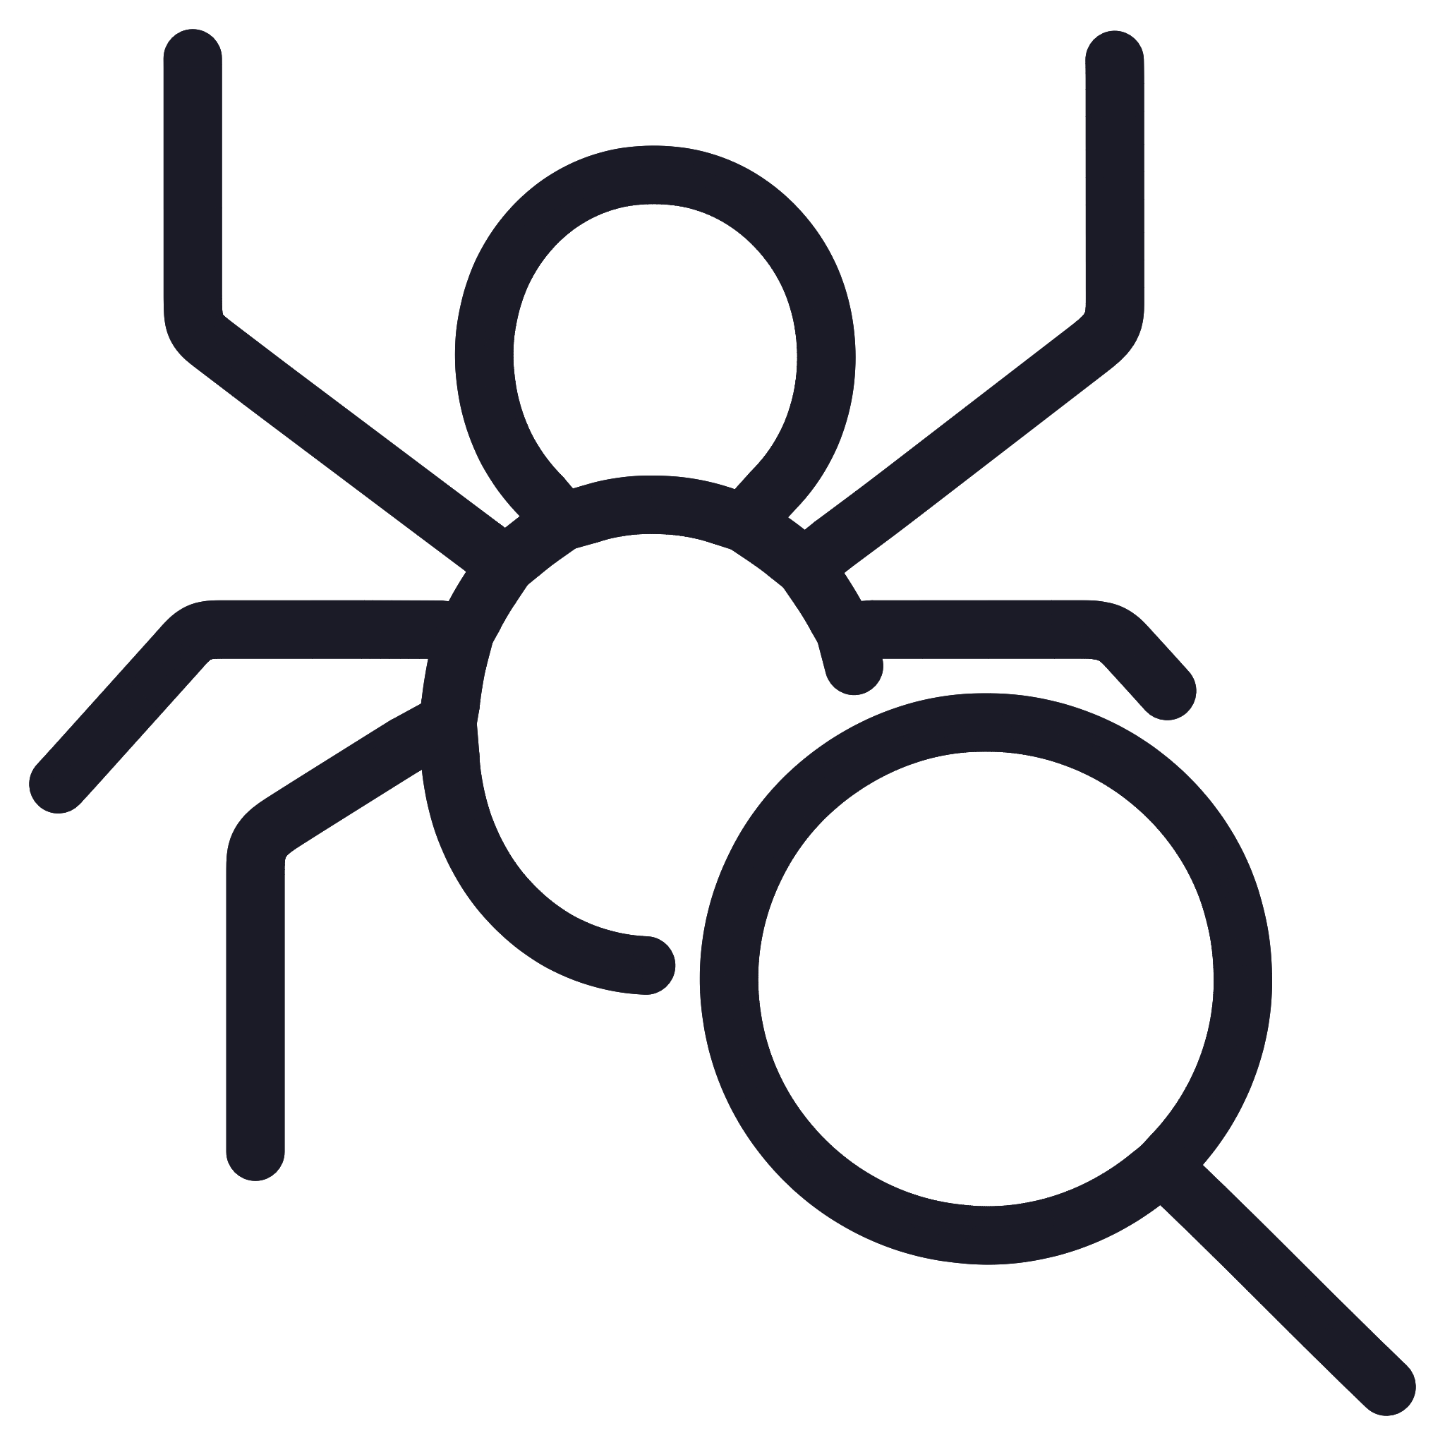
Campus App Features
Notices
Important announcements and updates for students delivered in real time to ensure everyone stays informed.
Events
Complete calendar of campus activities and social gatherings with RSVP functionality and reminders.
Bookings
Streamlined reservation system for campus resources and facilities with conflict prevention.
Lost & Found
Dedicated platform to report and retrieve lost items with photo uploads and direct messaging.

Slide 10

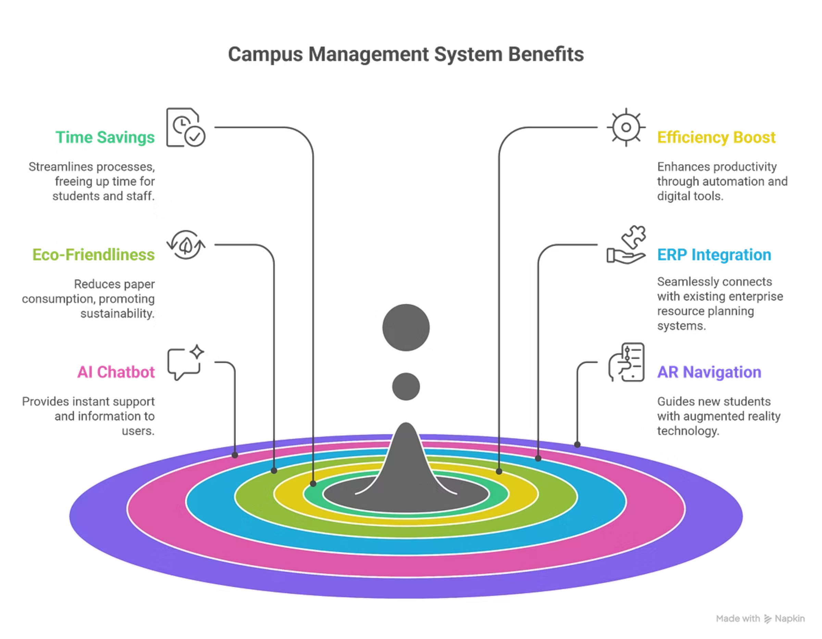



Campus App Tech Stack
Design Tools
Figma Prototype: Interactive design for user experience, ensuring intuitive and visually appealing interfaces.
Frontend
Flutter and React Native: Robust front-end frameworks used for building cross-platform user interfaces, delivering a consistent experience.
Backend
Node.js and Firebase: Powerful back-end frameworks responsible for core application functionality, real-time data handling, and scalable operations.
Database
Firestore and MongoDB: Flexible and scalable databases for efficient data management, storage, and retrieval across the application.

Slide 11

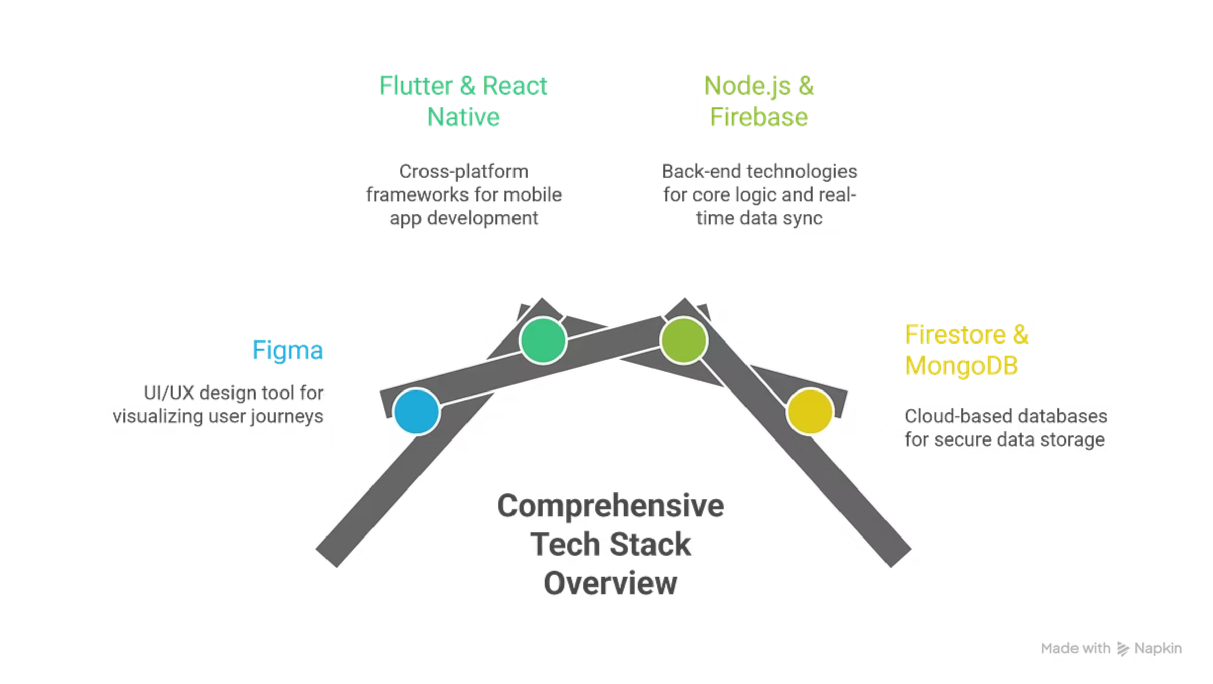



Campus App Tech Stack Deep Dive
Figma Prototype
Interactive design for user experience, ensuring intuitive and visually appealing interfaces through high-fidelity UI/UX designs and user journey visualization.
Frontend: Flutter & React Native
Robust cross-platform frameworks for building responsive and visually appealing mobile apps, ensuring consistent performance, faster updates, and reduced development time across Android and iOS.
Backend: Node.js & Firebase
Powerful back-end frameworks handling core logic, API integration, and real-time data sync. Provides scalable server-side processing, authentication, cloud functions, and notifications.
Database: Firestore & MongoDB
Flexible and scalable cloud-based databases for secure, structured data storage and efficient management of campus data, supporting real-time updates and offline access.

Slide 12
Student & Admin Interaction Flow
👨‍🎓 Student Actions
👨‍💼 Admin Actions
📢 Checks Notices:
✅ Approves Booking:
Students access the campus bulletin board to stay informed about announcements, events, and updates.
Admin reviews and approves or declines hall booking requests based on availability and event type.
🏛️ Books Hall:
📊 Views Analytics:
Students can reserve halls or auditoriums for events, meetings, or club activities through a simple online booking interface.
Admin accesses usage statistics, booking frequency, and system reports for efficient resource management.
📁 Reviews Data:
🧳 Posts Lost Item:
Admin monitors and manages student activity data, booking history, and platform performance for transparency and improvement.
Students report lost or found items by uploading details and images to the Lost & Found board, helping others retrieve belongings easily.

Slide 13
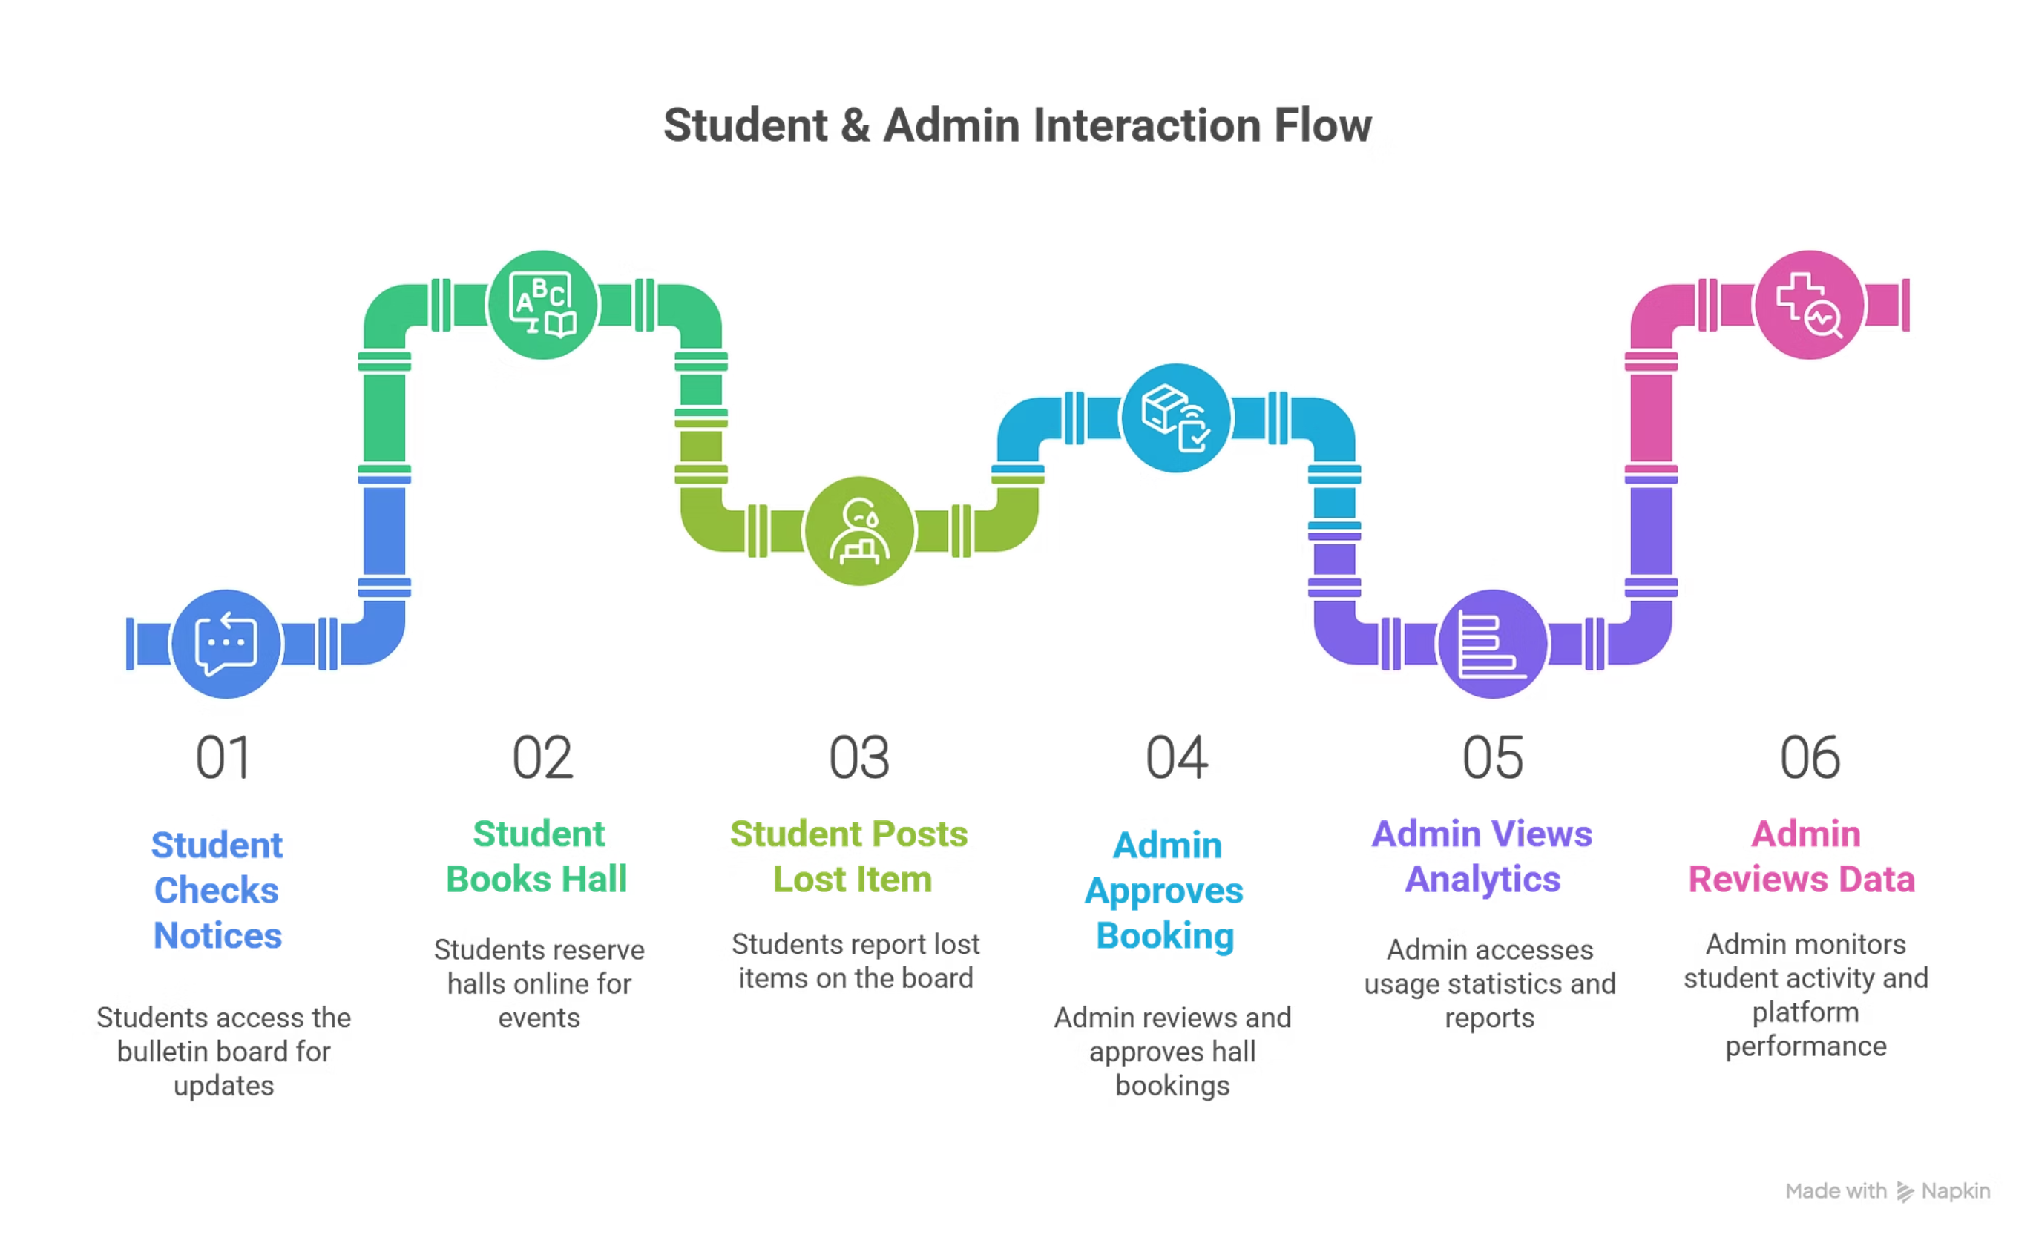

Slide 14
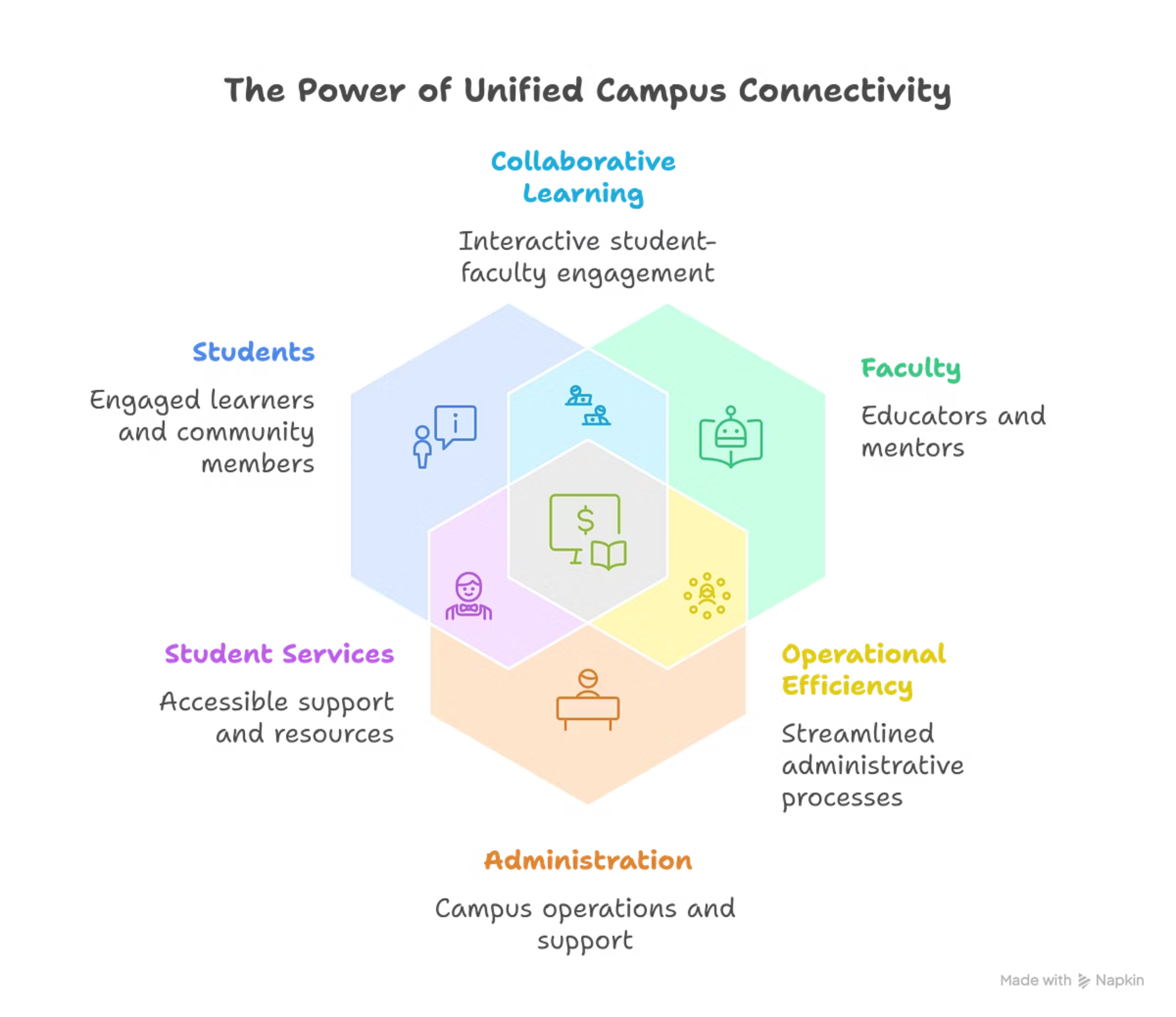
Conclusion
Campus Connect transforms traditional campus communication into a smart, connected ecosystem.
It bridges the gap between students, faculty, and administration through one unified platform.
Enhances efficiency, transparency, and sustainability by digitizing daily operations.
With future integration of AI and IoT, it can evolve into a fully smart campus solution.
Empowering campuses to stay connected, informed, and inspired.

